Slide 1
Catapult Training Templates

Slide 2
Discrimination & Harassment for Supervisors and Managers
Subtitle Goes Here
Location / Date / Goes Here

Slide 3
Agenda
Protected Classes
What is Harassment?
What is Retaliation?
Perceptions & Outcomes
Supervisor Actions
Notes:
This is our agenda today as we talk about harassment.
We’re going to first talk about all of the classes protected by law, and really get clear on what harassment and retaliation are.
This will lead us into a discussion of how certain actions can be perceived as harassment.
And lastly, we will discuss what you as a supervisor can do to make sure you have a workplace free of harassment.

Slide 4
Overview of Anti-Discrimination Law
Protected Classes
Race, Color
Religion
Gender
Sexual orientation
Transgender
Pregnancy
National Origin
Citizenship
Notes:
So, which classifications are protected from harassment?
Well, the list varies. So this list and the one on the next slide are not all inclusive of some of the areas protected by law from discrimination. These laws may be added to on a state by state or even city by city basis.
For example, NC protects employees from discrimination in lawful use of legal products outside the workplace. NC’s law covers smoking for example. You cannot take adverse action against someone for their legal us of tobacco outside of work; however you can enforce no tobacco policies at work.
Do any of these protected classes surprise or confuse you?
And how can harassment happen in these areas? We hear about sexual harassment, but what is national origin harassment or citizenship harassment?
Discuss – You may hear things like “white people aren’t protected” or “why do people here illegally get more protections than us?” and here are some thoughts to bring up as needed, as well as questions to get the conversation rolling:
Are white people protected?
Imagine a work environment where the workforce was mainly non-white, and the white people were treated differently because of their race or color. People made jokes about how they didn’t work hard and how they were entitled. The supervisors tended to put the white people together in the lowest paid department.
So, yes – while you normally hear about discrimination against other races, since whites are in the majority in many companies and often it is the minorities that are harassed, these laws are meant to protect everyone.
What about men?
Yes – Gender is a broad classification. If you are harassing someone because they don’t conform to your ideas of how a female or male should behave, it is a problem. As an example, if you were to give a baby shower to every new mom, but tell new dads that they need to get back to work, you are telling the dad that they are expected to put work first, while mothers are expected to put their kids first. In fact, there have been lawsuits over maternity leave policies by new dads which have been successful.
If someone is not legal to work in the US, is it OK to harass them or discriminate against them?
NO. If you were to discover someone was not legal to work in the US, we would certainly need to verify that and not have them employed because we are not allowed to have them working for us, but you cannot harass them. In addition, many workers are not US citizens but are legal to work in the US, and their citizenship status should not be a cause for harassment or discrimination.

Slide 5
Overview of Anti-Discrimination Law
Protected Classes
Age
Disability
Veteran’s Status
Union Membership
Genetic Information
Retaliation laws include FMLA, W Comp....
Notes:
Employees who are 40 or over are a protected class. This is one of those occasions where truly certain people are not protected. So, younger workers legally are less protected, which obviously does not mean we should harass or discriminate against them.
In fact, for every young person who calls older workers “boomers”, there is an older worker who patronizes younger workers by treating them as though they are not knowledgeable or worth listening to. Both of those actions are demeaning to the other side. However, the “boomer” comment is one that could be seen as potentially harassing to an older worker.
Individuals with disabilities are another protected class, whether their disabilities are mental or physical. Some disabilities are obvious; others less so. When you joke with someone for their manner of talking, thinking or reacting, or maybe for their need to take a break more frequently, consider that some of these things may be due to a disabling condition. It is always best to be sensitive and show respect for differences, versus pointing people out for them. This type of action can make people feel different in a bad way.
Veteran’s status, Union membership are other protected classes. Some employers choose to hire veterans intentionally; other employers may feel that being a veteran means that someone is going to behave differently than the average worker and it could cause them to discriminate.
Genetic information is another protected class. Often this can go hand in hand with a disabling condition, but not all of the time.
Finally, there are other protected activities which are legally protected from retaliation even though they may not be a protected class from a civil rights standpoint. For example, FMLA leave, reporting a safety issue or requesting workers comp are all protected actions.

Slide 6
Harassment and the Work Environment
What is Permitted?
What is Ignored?
What does the boss do?
How is behavior corrected?
Address before “snowball”?
Notes:
Harassment is pervasive in some work environments. We have probably all worked in them. Maybe some of us have had a good time in those work environments because the behaviors did not impact us, or they didn’t seem to bother anyone.
As a manager, think about your department. What types of employee behaviors are displayed. Do you hear comments about customers after they walk out the door? Do you hear giggling from employees when a fellow worker brings up a personal situation?
How do you address these situations? If you assume that because nobody complains, everything is fine, you are permitting behavior.
By addressing behavior immediately and at the right level, in the right way, you are preventing your environment from snowballing into one which allows much worse and more pervasive behavior.
Let’s talk about the different types of harassment that can happen.

Slide 7
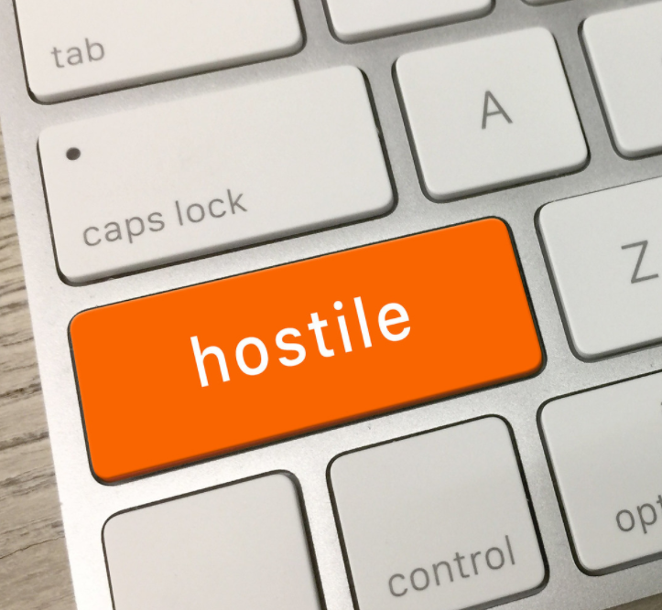
Hostile Work Environment
Unwelcome, AND
Based on a protected class, AND
Person feels it is abusive, AND
Severe/pervasive enough to create a work environment that a reasonable person would find hostile/abusive.
Notes:
One type of illegal harassment is a hostile work environment?
A hostile work environment happens when
Harassing conduct is unwelcome and based on the victim’s protected status.
Second, the conduct must be:
subjectively abusive to the person affected; and
objectively severe and pervasive enough to create a work environment that a reasonable person would find hostile or abusive.
How severe or pervasive the conduct is depends on many factors including
the frequency of the unwelcome discriminatory conduct;
the severity of the conduct;
whether the conduct was physically threatening or humiliating, or a just speech
whether the conduct unreasonably interfered with work performance;
the effect on the employee’s psychological well-being; and
whether the harasser was a superior within the organization.

Slide 8
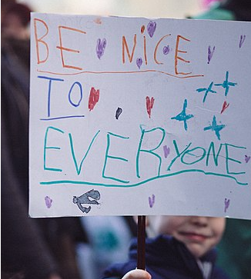
Other Harassment
Results in Employment Action, can include Quid Pro Quo
Examples:
Manager demotes a woman for rejecting his advances.
Older employee refuses to pose with a cane for birthday photo and is put on night shift.
Notes:
Harassment can take other forms than hostile work environment. It can include a single incident that results in an employment action.
This could be a situation where a manager penalizes an employee who refuses their sexual advances or declines to participate in activities that they feel are inappropriate or offensive based on one of the protected classes.

Slide 9
Sexual Harassment
Unwelcome conduct
Related to gender
At a level where a reasonable person would find it offensive.
If an employee asks someone to stop and the other person doesn’t, a behavior which is minor can rise to the next level.
Notes:
When do you, as a supervisor, know that two people who are flirting are actually harassing one another.
Well, the conduct has to be unwelcome and based on gender, as well as being at a level where a reasonable person would find it offensive.
But before you begin to think about whether you really need to know if it meets the legal definition of harassment, first of all consider what kind of a work environment you expect. Do you really want staff flirting heavily – is it professional?
In some cases, if it is consensual and minor, you just need to take both parties aside and say: “I know you have fun and enjoy each other’s company, but my line for a professional workplace is that people should not feel like others are flirting or having romantic innuendos going on.”
Again, maybe it is all consensual, but it is likely other employees really don’t want to have to watch.
If comments, cartoons, photos, videos or texts about body parts, sex acts and so forth pop up, those are obvious issues.
However, you should also address minor level issues with a verbal discussion. If they continue, it probably warrants corrective action.
While the behavior may not be pervasive and severe, it certainly can get to that level quickly without your intervention

Slide 10
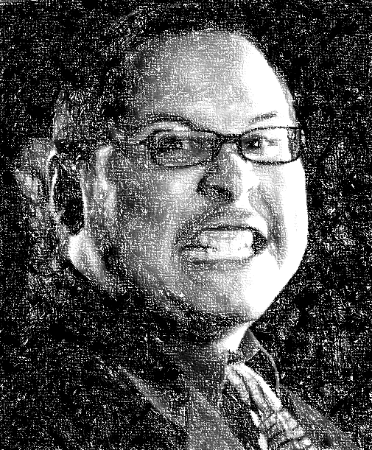
Retaliation
Frequently pairs with EEOC claims
Employee harassment complaint.
Employment action takes place.
Employee feels they are connected.
Notes:
Retaliation is often a part of EEOC claims related to harassment and discrimination because when employees report concerns, if employment actions take place soon after without appropriate justification, it is likely the employee will feel that they are being penalized for reporting their concerns.
What can happen is that an employee expresses a concern and then an unrelated employment action takes place. (This could be demotion, termination, a change in shift, change in title, reduced training options, or similar changes in their employment.)
Certainly, if you ever retaliate in this way as a supervisor, the company would terminate employment. Not only is it illegal but it demonstrates a lack of alignment with our leadership values and standards.
Sometimes an employee feels forced to quit because while an employer doesn’t do anything that affects their job or pay, they cut them out of training opportunities, meetings and basically force the employee to quit.
It is important that we welcome reports of concerns, whether they turn out to be serious or not. Without learning how employees feel, we can’t make the company better.

Slide 11
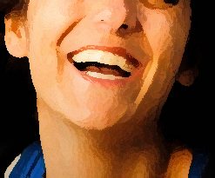
Perceptions
Most employees do not complain.
Jokes/Comments
Workers, teammates, customers.
Personal Questions
Avoid asking; avoid offering “friendly” advice & opinions.
Discussions on off-limits topics
People can feel judged.
Notes:
Does this mean you can’t have a fun atmosphere – no jokes? No talking about personal things?
No, but your goal is to have an atmosphere where everyone is comfortable and safe, as well as productive.
Having a fun environment comes second and a fun environment is only fun when it is fun for everyone and everyone is comfortable.
Remember that what you avoid addressing you are permitting.
The majority of employees never complain about their treatment. It is your role as a supervisor to try to stop treatment that may never be specifically complained about.
There are ways to do this for a minor level situation which can fit naturally into the conversation and simply remind people through your behavior that respect is important. Therefore, if you hear someone make a joke about someone being close to retirement age, what could you say?
(Discuss) – It doesn’t have to feel punitive; it can happen in the moment. For example, you can say: “Jane can never leave us, we need her too much!” instead of continuing the age-related joke.
As a manager, always ask yourself if what you are about to say is going to support people and make them feel safe. It is easy to get a laugh, but harder to create a good working environment.
In addition, while teammates may become close, everyone has a different comfort level and you never know when you may cross it. While we all have opinions, voicing them to others can make others feel judged and unwelcome.
When you start a conversation about transgender or bisexual people in the abstract, you may very well be upsetting someone who is transgender or bisexual, or who has a family member or friend who is, or you might be simply upsetting those employees who know that the conversation may have turned into a pattern of behavior which is known as a hostile work environment.
While we all have opinions, voicing them to others can make others feel judged and unwelcome.

Slide 12
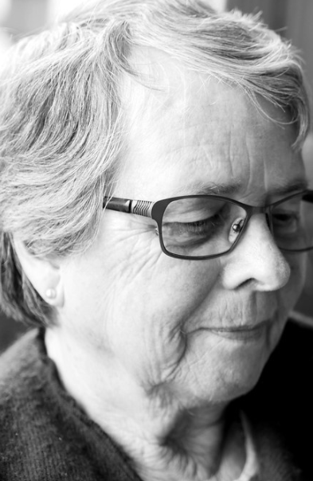
Discuss
In Jane’s interview, she was asked:
What year did you graduate HS?
After hire:
A teammate joked at her birthday: Shouldn’t you be retired?
Her manager added a joke about her “boomer” computer skills.
Need for a lay-off:
Jane picked over newer, younger co-worker due to “lower performance”.
Notes:
Let’s talk about an example of a possible workplace situation.
In Jane’s interview, she was asked: What year did you graduate from High School?
After hire a teammate joked at her birthday: Shouldn’t you be retired? And her manager added a joke about her “boomer” computer skills.
Later on, the manager decides to lay-off Jane. She isn’t as good a worker as a younger colleague who was hired a little bit later than her, but he never told Jane that, because she was OK too, just not quite as good.
What do you think Jane might feel the termination is really focused on?
(Discuss – Some ways to start conversations: “Do you think Jane felt it was funny? Why would you ask about a date someone graduated from high school – what message does it send?”
Jane has heard jokes about her age all along, and the unnecessary age-related question in the interview means, to her, maybe the manager had concerns even before she was hired. Maybe they just hired her because they were worried she would sue them otherwise. And now the lay-off is just a hoax to get rid of her. After all, the manager has always told her she is a good employee. And the worker they are keeping was hired after her.

Slide 13
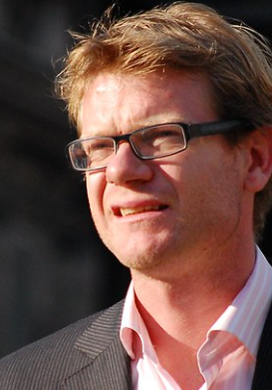
Quiz
Ted & Mary flirt at work.
Ted doesn’t mind Mary calling him a “sexy man” and making comments about his body.
Jeff finds the conduct upsetting.
Jeff has expressed his concerns:
He has told them to stop several times.
He has also told his supervisor their conversations bother him.
Notes:
Here is another harassment scenario. So, is this a sexual harassment claim waiting to happen?
Discuss:
Is the conduct unwelcome?
Is it related to a protected class? (Gender)
Is it severe or pervasive? It seems like it is if he has talked to them several times.
In addition, the fact that the actions may be minor is true, but doesn’t it get to be more major when they keep going when they know others are uncomfortable.
What should the supervisor have done, and what should they do now? (DISCUSS)

Slide 14
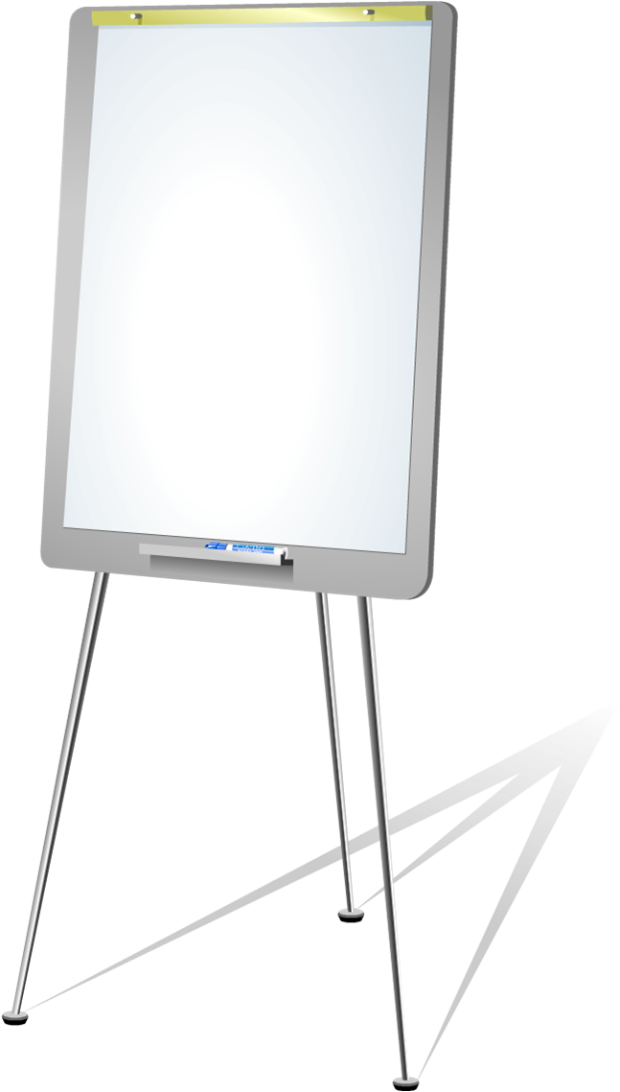
Rules for Creating a Respectful Environment
Set expectations upon hire
Describe what professionalism means in
your department.
Remind them: Think how others feel
Jokes about age groups, sex, race and
so forth are not appropriate
Notes:
Everybody has a different idea of what professionalism and appropriateness mean. For that reason it is important to define those in your Department from the very beginning of employment. Make sure your employees understand the jokes about age sex race national origin and so forth are not tolerated. Remind them to think before they speak and to consider how their comments may make others feel.

Slide 15
Rules for Creating a Respectful Environment
Don’t forget social media
Supervisors: Best to avoid friending staff.
Remind staff: Think before posting.
Behavior that is harassing at work will be seen as such online.
Notes:
In this day and age, social media can be the primary way that people communicate. It is important that supervisors use social media with discretion.
Once you connect with your team on social media, they will assume that you were aware of comments that are inappropriate online.
It is best to avoid connecting with your team and also let them know that behavior that is seen is harassing at work is going to be seen the same way online.
If you have complaints from co-workers or customers about online behavior, you will investigate them in the same way.
Staff should bear in mind that all of their postings should be considered from the aspect of how they want to represent themselves online and in person. It is easy to post but hard to take back the post unseen.

Slide 16
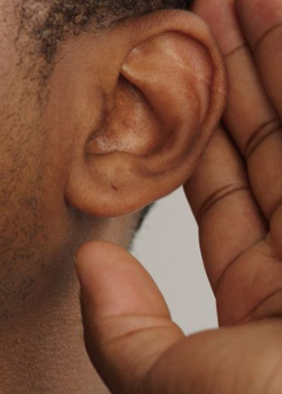
Supervisor Guidance
LISTEN & ASK
Did I hear you comment about Alexander’s turban?
How do you think that made him feel?
I noticed Bob has been talking to you about your religious beliefs.
Notes:
Another responsibility you have as a supervisor is to listen and observe.
Try to get a feeling for how people see others in the department.
Who is sitting alone at lunch?
Do you see gossip? Are people awkward, rude or silent?
Do you sense tension?
If you hear things or see things that bother you, ask questions. Find out what is going on. It is hard to assess a situation without learning more about it.
Asking questions can feel rude, but it is a part of your job. “Mary, I heard Joan talking to you. She mentioned something about Asian people and it seemed to be in an angry tone. What is going on?”

Slide 17
Supervisor Guidance
Correct actions ASAP
Do not ignore issues
Be kind/respectful
Mess up? Apologize.
Notes:
If you see something of concern, don’t just hope it will go away.
And don’t put off addressing it. First of all, more harassment could ensue in the meantime, but it also makes the employee question why you waited so long.
As a supervisor, you must be willing to confront issues and this means being comfortable and calm when there is potential conflict.
If you have trouble with that, work with your own supervisor to get training on managing conflict.
As soon as you hear a concern, address it. Sometimes, as we have discussed it is simple and unobtrusively adding something to another’s comment to remind them of common rules of respect.
If the issue is bigger, you need to take them aside and politely address it.
The best way to address smaller issues is to let them know of the behavior, and let them talk. Listen, then let them know how it impacted or could have impacted others. Let them know your expected behavior then get their agreement.
Set an example by using respectful language, being inclusive and asking others’ thoughts.
And if you mess up, just apologize. For example, if an employee corrects you for a remark that seems sexist or racist, instead of getting defensive, thank them for giving you the heads up and apologize for the comment.

Slide 18
Supervisor Guidance
Always Document.
For Bigger Issues:
Immediately contact HR
Assess safety
Suspend if necessary
Notes:
Minor issues are one thing. Anything that rises above that level is another.
However, you should have a supervisor notebook kept securely where you note discussions and dates in just a few words. This can be in a calendar or journal.
For example: Reminded Bob that mentioning customer appearance is not appropriate.
It doesn’t have to be detailed.
By documenting those minor issues, you leave a record so that if future issues happen we can see they were discussed previously. Even better, put a signed, dated memo of the discussion in their file if it is behavior that was more than just accidental and very minor.
If someone is very upset, that is a sign that you need to call HR in.
If something is obviously offensive, that is another good sign that you need to contact HR.
If someone feels they are being harassed, then that is another good sign you need to contact HR.
We will help you assess the situation. In some cases, it is important to suspend the alleged harasser pending an investigation.
It is never appropriate to shift an employee who is complaining to another area or shift. This can be seen as retaliation or an adverse employment action later, even if not now.

Slide 19
Q
I
U
Z
TIME
Joan tells Jim he looks nice today.
Tell Joan that Jim may not like that comment.
It was said politely; skip it.
Call HR.
Notes:
It is quiz time.
Joan tells Jim he looks nice today.
Tell Joan that Jim may not like that comment.
It was said politely; skip it.
Call HR
So, in this case, unless Joan said it while doing something else or in a tone of voice that made it creepy or sexual, Joan is just being polite.
Any other cases when you would have concerns?
No need to call HR here.

Slide 20
Q
I
U
Z
TIME
Maria’s co-workers say “go home to Mexico”
Maria is rolling her eyes – all OK here.
Written, final warning for co-workers.
Call HR.
Notes:
What about Maria’s co-workers who say “go home to Mexico” – none of them get along, but it is back and forth all day. Maria just rolls her eyes and says something rude back.
Maria is rolling her eyes – all OK here.
Written, final warning for co-workers.
Call HR
In this case, you should call HR – This is obviously language which is unwanted and is based on National Origin. It needs to stop. Best to get HR involved, although number 2 – a final written warning – might be appropriate in some cases.

Slide 21
Q
I
U
Z
TIME
Muhammed is in a wheelchair. His co-worker tells him he can’t handle inventory work – she’ll do it.
Thank the co-worker for being helpful.
Discuss “assumptions” co-worker is making.
Call HR.
Notes:
Muhammed is in a wheelchair. His co-worker tells him he can’t handle inventory work – she’ll do it.
Thank the co-worker for being helpful.
Discuss “assumptions” co-worker is making.
Call HR
So, the co-worker is making an assumption about Muhammed in this case. You don’t need to call HR if she is just trying to help, but it is important to educate the co-worker. First, though, you might want to talk to Muhammed. Maybe Muhammed told his co-worker that he can’t do the inventory work himself. Otherwise, unless Muhammed obviously needs help or asks for it, he would probably prefer to be treated as though he was just as competent as the rest of the team.

Slide 22
Questions?

